Slide 1
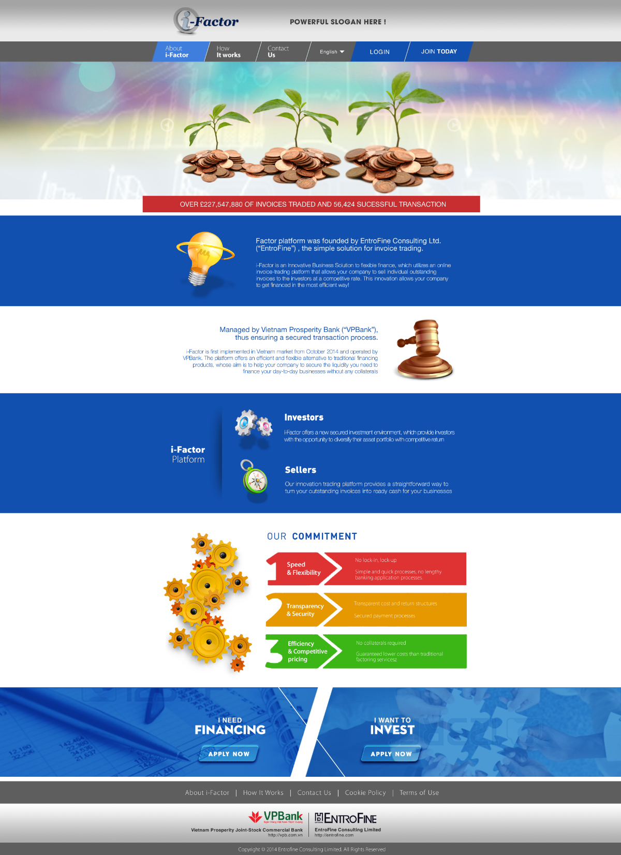
Req 3: Block 1 will appear as people access website at the first time.
Req 1: Support screen resolution from 1024x768 -> 1366x768 (landscape style).
Block 1
Req 2: Font: the same as User interface of Online platform (UI).
Req 4: When scrolling down it will be move from block 1 to block 2 or block 2 to block 3, step by step. Not move to fast.
(reference: http://www.platformblack.com.
Block 2
We use static HTML only or have a management website for update, maintenance after launching? (Content management/admin site).
Req 5: Block 2 and Block 3: Overlap the ‘Our Commitment’ Section.
Block 3

Slide 2
Req 8A - Opt 1: Using a fixed photo and be changed periodically by authorized user. Photo will be replaced by another one but same size and same dpi (quality).
Req 6: Final photo will be replaced by another one but same size and same dpi (quality).
Running word
Req 7: Running words.
Req 8B - Opt 2: Photos will be automatically changed after 5s. It will be 3-4 photos run as slide show
Pls estimate the time to develop this effect.
Req 9: When user clicks “i- Factor Platform”, he will be redirected to “About i-Factor” page.

Slide 3
Req 10: When user clicks “I-Factor” icon, he will be redirected to homepage page.
Req 13: When a tab is selected, it must be changed to lighter color, other tabs will be changed to dark color.
Req 14: When a tab is clicked, redirect user to login page or online platform home page.
Req 11: When user clicks “Investors” or “Sellers” icon, he will be redirected to “How It works” page.
Req 15: When user clicks “I need financing”, he will be redirected to seller registration page, When user clicks “I want to invest”, he will be redirected to Buyer registration page.
Req 12: When user clicks Word phases: About i-Factor, How It works, Contact us, Cookie policy, Term of use, he will be redirected to sub-page accordingly.
Req 16: VPB homepage (http://vpb.com.vn) and Entrofine homepage (http://entrofine.com).

